Slide 1
Pakistan Education & Research Network (PERN2) Operations
Higher Education Commission
Govt of Pakistan

Slide 2
Agenda
PERN2 Network Overview and key objectives
Interconnectivity between PERN2 and other NREN`s
PERN2 NOC

Slide 3
PERN2 Overview
Pakistan’s National Education & Research Network.
A Digital Dedicated Communication Network interlinking 156 Public & Private Sector Universities in Pakistan.
A vision to enhance the Education & Research capabilities among the students of Pakistan.
Provide integration of data banks, collaboration for research and development activities and up-gradation of teaching and learning skills.
Connected to other Education & Research Networks World wide for fruitful R&D.

Slide 4
PERN2 Overview (contd..)
PERN2 Motive
PERN2
Research
Internet
Distance Learning
Managed Services
Intranet

Slide 5
PERN2 Overview (contd..)
PERN2 Network Overview & Transmission Services Overview
Network up-gradation through
Three (3) Regional Access PoPs
Twelve (12) Local Access PoPs in major cities
10Gbps metro rings in Karachi, Lahore & Islamabad
5Gbps Commodity Internet bandwidth
1Gbps (40 times faster) connectivity to all the Universities/institutes connected to PERN2
155Mbps Link with TEIN3

Slide 7
Interconnectivity between pern2 and other nren’S
Partners Role in PERN2
PERN2 Linkage to other NREN`s & current status
Applications & Research Project

Slide 8
Interconnectivity between pern2 and other nren’S (Contd..)
Partners
Asia-Pacific Advance Network
Primary Member of APAN of Asia and Australia
Pak-EC Joint Commission on Science & Technology
DANTE: Collaborating partner representing GEANT2 of Europe and TEIN2/3 of ASEM (Asia-Europe Meeting)
Pak-US Joint Commission on Science & Technology
NSF/IU: Collaborating partner representing Internet2 of USA
Pakistan-UAE Partnership on NRENs (in progress)
Ankabut: Collaborative partner representing NREN of UAE

Slide 9
PERN2 Network Operations
Network Operation Center
Network Management System
Customer Relationship Management (CRM)
Information Store & Web portal
Security portal

Slide 10
PERN2 Network Operations (CONTD..)
Network Operation Center
Central NOC at HEC national TEIR2 level DATACENTER in Islamabad
NOC Team has been Deputed 24X7X365
Engineers are deputed on each PERN2 POP site (Karachi , Lahore, Peshawar, Quetta & Multan)

Slide 11
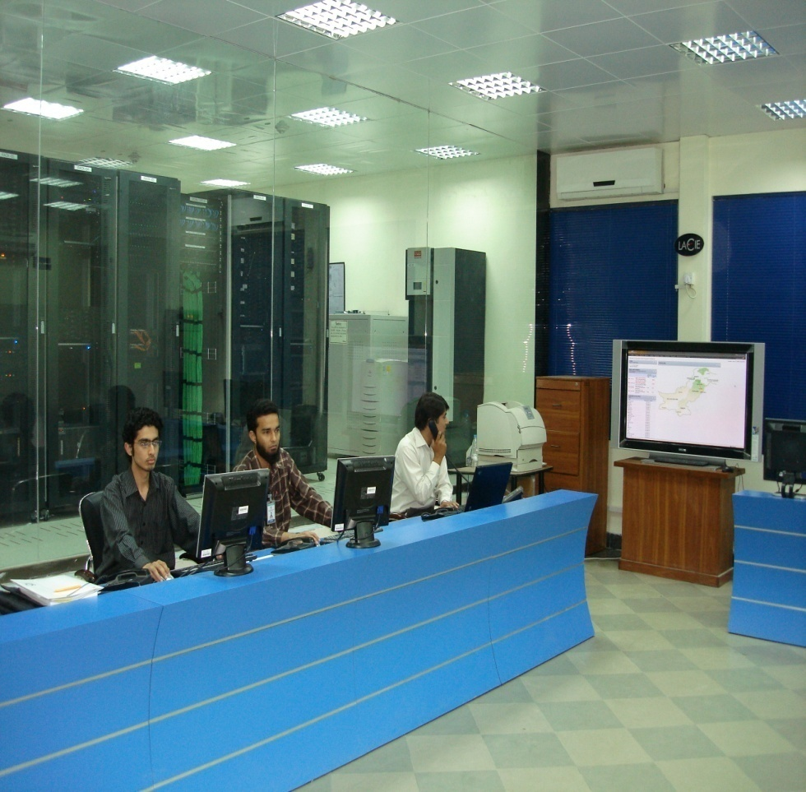
PERN2 Network Operations (CONTD..)
View of PERN2 Central NOC

Slide 12
PERN2 Network Operations (CONTD..)
Network Monitoring services
Primary NMS is Solarwinds
Secondary NMS is Huwaei DMS
Multisite Monitoring (Islamabad – Karachi) - Redundancy
Web Access to Universities / Engineers
24X7 Monitoring

Slide 13
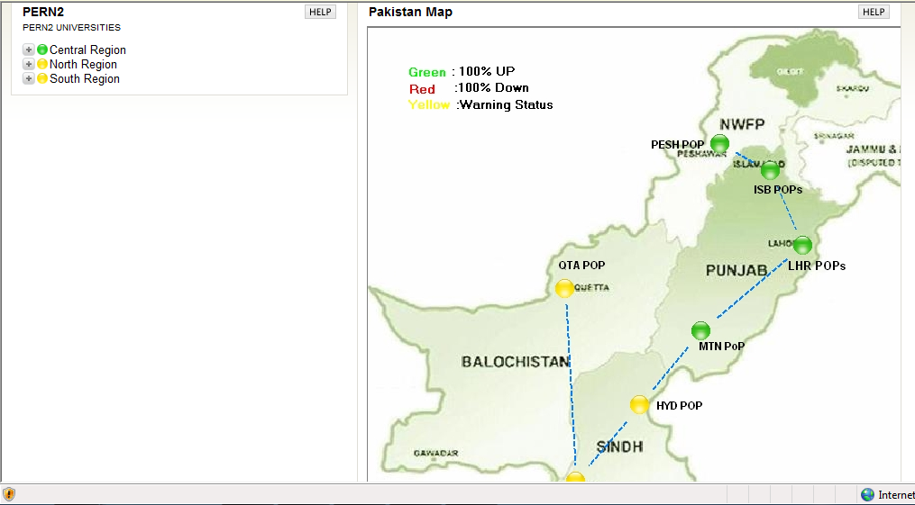
PERN2 Network Operations (CONTD..)
PERN2 NMS

Slide 14
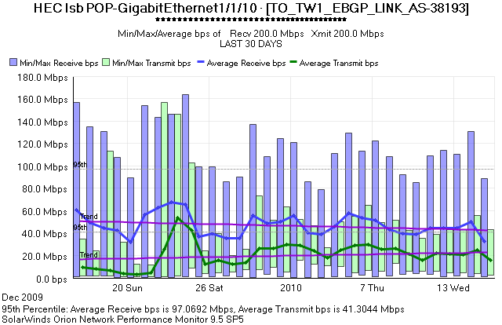
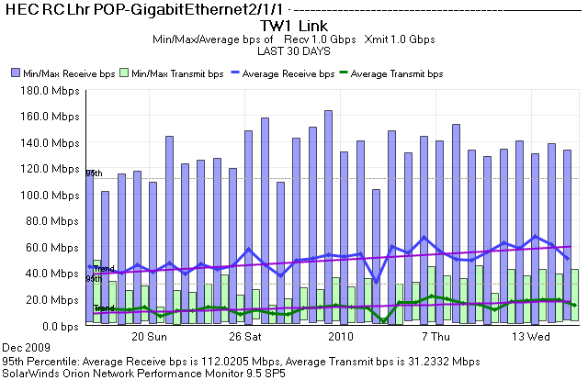
Last 30 Days Graph of PTCL link at ISB
110-MB Bandwidth
Last 30 Days Graph of TWI link at KHI
155MB Bandwidth
Last 30 Days Graph of TW1 link at ISB
200MB Bandwidth
Last 30 Days Graph of TWI link at LHR
265MB Bandwidth

Slide 15
Customer Relationship Management (CRM)
Service Communicator
Generates Tickets
http://sc.hec.gov.pk
Account of Every University / Institutes Available.
They can log their Complain through this portal.
24/7 Help Line also Available i.e 111-11PERN & 051-9040PERN
Complain also can log by email pern2@hec.gov.pk

Slide 16
THANKS

